Slide 1
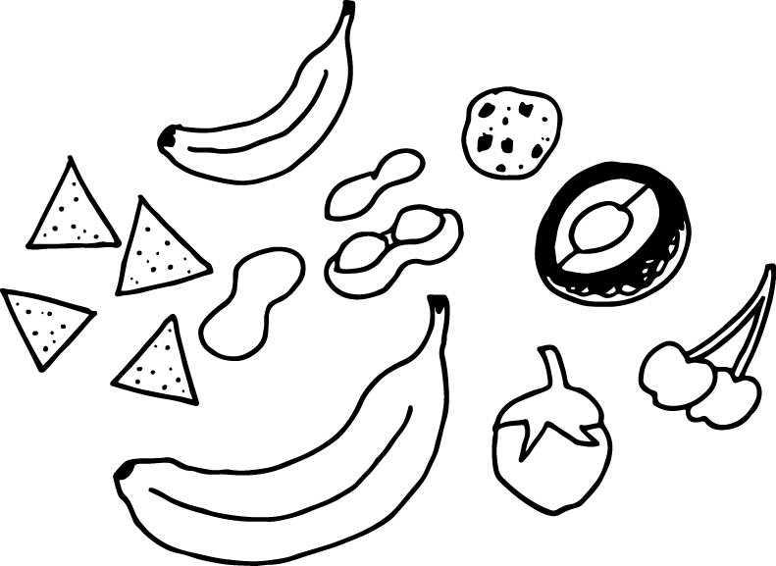
Digest this!
A role play to explore the process of digestion
Source #1 -http://www.innerbody.com/image/digeov.html#full-description
Source #2 http://www.precisionnutrition.com/food-is-not-fuel

Slide 2
Here’s how to do this role play
Everyone (or pair of students) gets one slide
Some students will be the parts of the body involved in digestion, others will be different types of food.
Ask the students to put themselves in order! See what they already know about digestion. Make sure everyone is in the right order.
Have student identify the food as “protein” “carbohydrate” or “fat/ lipid”
Remind students that the energy is in the bonds in the food!
Have students figure out what kind of movement you will use to “act” your part either in the digestive tract or as a different type of food
The food will be “consumed” and as the food moves through the body - each part will describe its function and do the move
Another food will get eaten - repeat the process - make sure everyone knows where the food is absorbed (you don’t have to read the entire slide each time around)

Slide 3
Mouth

Slide 4
Mouth
Food begins its journey through the digestive system in the mouth.
The mouth also has the tongue, teeth, and salivary glands that help digest food.

Slide 5
Teeth

Slide 6
Teeth
Teeth. Adults have 32 teeth. The teeth are designed for cutting and grinding food into smaller pieces.
Each tooth is made of a bone-like substance called dentin and covered in a layer of enamel—the hardest substance in the body.
Teeth are harder than bones.
Teeth are living organs! They contain blood vessels and nerves under the dentin in a soft region known as the pulp.

Slide 7
Tongue

Slide 8
Tongue
Taste buds on the tongue taste in food and the nerves in the tongue send that information to the brain.
The tongue helps move food along!
The tongue is not just one muscle - it is a few different muscles all bundled together.
The outside of the tongue is slightly rough so it can grab food!

Slide 9
Salivary glands

Slide 10
Salivary glands
Salivary glands produce saliva!
Saliva moistens food so it can move through the body.
Carbohydrates begin to be digested as soon as they enter your mouth!
Amylase is the enzyme that digests carbohydrates, and is present both in the mouth and in the small intestine.

Slide 11
Pharnyx

Slide 12
Pharnyx
The pharnyx is a fancy word for throat!
The throat brings food and also helps bring air into the body.
There is a flap of tissue called the epiglottis - it helps direct food to the stomach and air to the lungs.
If the epiglottis doesn’t close fast enough, you can get some food in your windpipe - also known as choking. Usually coughing gets the food out!

Slide 13
Esophagus

Slide 14
Esophagus
The esophagus carries food from the throat to the stomach.
At the end of the esophagus by the stomach, there is a muscle called a sphincter.
The sphincter is like a gate - it can close to trap food in the stomach
“Heartburn” happens when the sphincter does not close and some of the acid from the stomach gets into the esophagus.

Slide 15
Stomach

Slide 16
Stomach
The stomach is a muscular sac
The stomach stores food to allow the body time to digest.
The stomach also helps digest food with hydrochloric acid and enzymes.
Fun Facts
Your stomach is about the size of your two fists next to each other
Your stomach is on the left side of your body.

Slide 17
Liver

Slide 18
Liver
The liver is triangular shaped and is located right next to the stomach.
The liver weighs about 3 pounds and is the second largest organ in the body.
The liver makes bile, one of the chemicals that helps digest food, and secretes bile into the small intestine.

Slide 19
Gall bladder

Slide 20
Gall bladder
The gallbladder is a small, pear-shaped organ located next to the liver.
The gallbladder is stores and recycles excess bile from the small intestine so that it can be reused for the digestion of subsequent meals.

Slide 21
Pancreas

Slide 22
Pancreas
The pancreas is a large gland located below the stomach.
It is about 6 inches long and shaped like short, lumpy snake.
The pancreas releases digestive enzymes into the small intestine to complete the chemical digestion of foods.

Slide 23
Small intestine

Slide 24
Small intestine
The small intestine is a long, thin tube about 1 inch in diameter and about 10 feet long!
Fats are digested in the small intestine by an enzyme called lipase. Carbohydrates and Proteins are also digested here.
The entire small intestine is coiled like a hose and the inside surface is full of many ridges and folds. These folds are used to maximize the digestion of food and absorption of nutrients.
By the time food leaves the small intestine, around 90% of all nutrients have been extracted from the food that entered it.

Slide 25
Large intestine

Slide 26
Large Intestine
The large intestine is a long, thick tube about 2 ½ inches in diameter and about 5 feet long.
It is located just below stomach and wraps around the superior and lateral border of the small intestine.
The large intestine absorbs water and contains many symbiotic bacteria that aid in the breaking down of wastes to extract some small amounts of nutrients.
Feces in the large intestine exit the body through the anal canal.

Slide 27
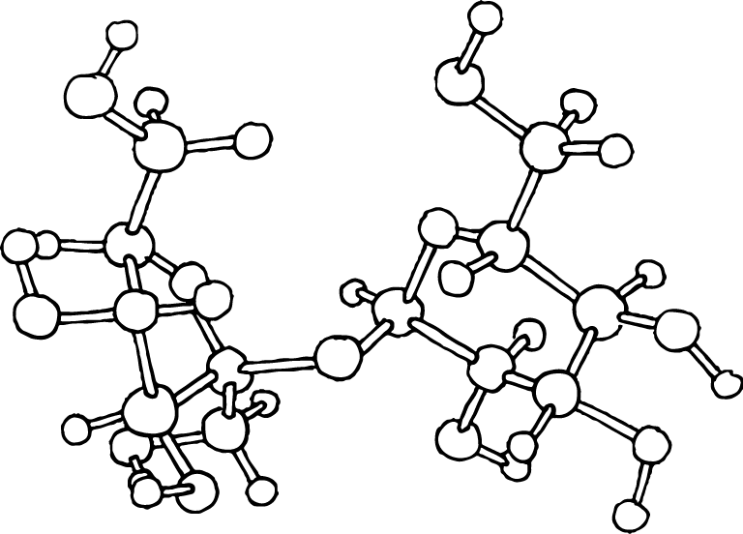
Carbohydrates

Slide 28
Carbohydrates
Carbohydrates start getting digested in the mouth - amylase (enzyme in saliva)
All carbohydrates are broken down into glucose - a type of sugar
Carbohydrates are also digested in the stomach and small intestine
Communication
Glucose sends a message to the stomach to release molecules (GIP and GLP-1)
2. These molecules send a message to the pancreas to release insulin
3. Insulin travels throughout the body and prepares the body for food intake.
4. The more glucose that’s ingested, the more chemicals released in the body.

Slide 29
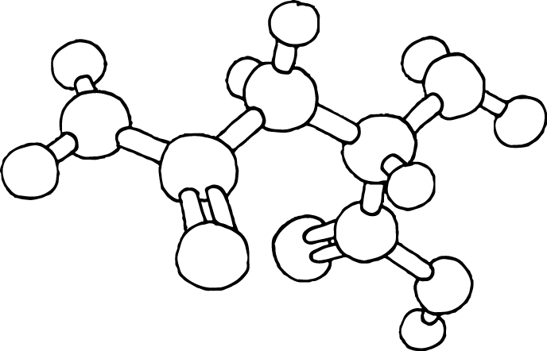
Proteins

Slide 30
Proteins
Proteins start to get digested in the stomach and small intestine
Communication to the body
When proteins are digested, they release chemicals that tell the pancreas to make more enzymes for digestion

Slide 31
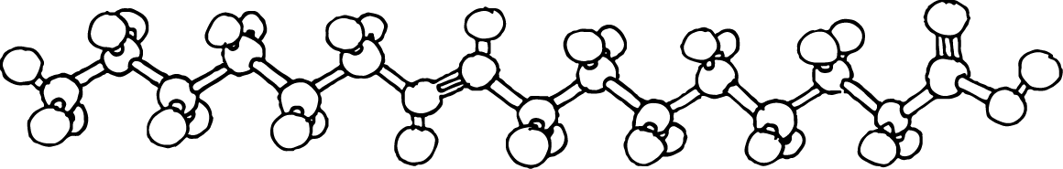
Lipids (fats)

Slide 32
Fats
Fats start to get digested in the small intestine - lipase (lipids = fat) is the enzyme that digests fat
Communication to the body
When fats are digested, they release chemicals (CCK) that tell the gallbladder to release bile
Bile helps with fat digestion and absorption
Bile also helps tell the brain that you’ve had enough to eat
CCK also affects pain management and mood

Slide 33
Vitamins

Slide 34
Vitamins
Vitamins are also important to a healthy diet! There are many vitamins - here are a few examples
Vitamin A Vitamin A has multiple functions: it is important for growth and development, for the maintenance of the immune system and good vision
Vitamin A is found in these foods - Liver, orange, ripe yellow fruits, leafy vegetables, carrots, pumpkin, squash, spinach, fish, soy milk, milk
Vitamin C is an essential nutrient involved in the repair of tissue.^{[1]} Foods that contain vitamin C include citrus fruit, tomatoes, red peppers, and potatoes.[

Slide 35
Minerals

Slide 36
Minerals
We need minerals in our diet. Without them, our bodies break down.
Calcium helps
build bones,
clot blood,
regulate blood pressure,
keep our muscles and heart pumping, and
maintain cell communication.
Magnesium plays a role in more than 300 enzyme systems and helps with:
protein synthesis,
muscle and nerve function,
blood sugar control, blood pressure regulation,
energy production, and
transport of other minerals.

Slide 37
Ham

Slide 38
Cheese

Slide 39
Crackers

Slide 40
Chocolate

Slide 41
Grapes

